Slide 1
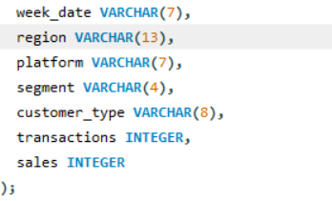
Weekly Sales Data Analysis
Columns
Week Date
Region
Plateform
Segment
Customer Type
Transactions
Sales
Regards,
Ankit Gangwar
Email
Github
Linked In

Slide 2
Introduction:::
"Welcome to the World of Data Insights! In today's presentation, we embark on a journey through the fascinating realm of weekly sales analysis powered by SQL. As businesses strive for agility and informed decision-making, we delve into how leveraging structured query language has uncovered valuable patterns and trends within our weekly sales data. Get ready to witness the transformation of raw numbers into actionable insights that drive strategic decision-making."

Slide 3
Overview
In weekly sales data are some enough columns for insights and some columns I addes by sql Queries’ , the impact of our SQL-driven analysis becomes crystal clear We've not only examined the numbers but also unearthed meaningful insights that hold the potential to shape our business strategy. The story told by the data is more than just statistical; it's a guide for informed decision-making. SQL, our tool of choice, has proven to be the key that unlocks a treasure trove of knowledge. As we reflect on the insights gained, we envision a future where data continues to guide and propel our business forward. Thank you for joining us on this analytical odyssey, where data isn't just numbers – it's the heartbeat of informed choices and strategic success."

Slide 4
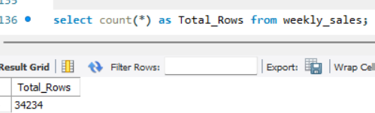
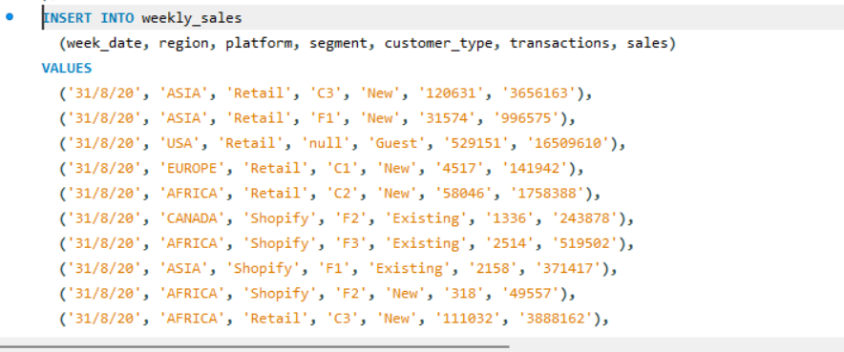
Insert Data in Columns
After creating the tables I insert the data in the tables.
Here total rows are 34234.

Slide 5
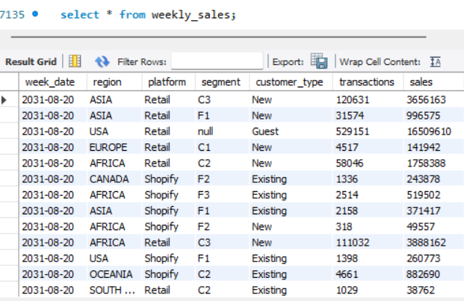
Retrieve the data that we have insert in Tables”:
Select * from weekly_sales

Slide 6
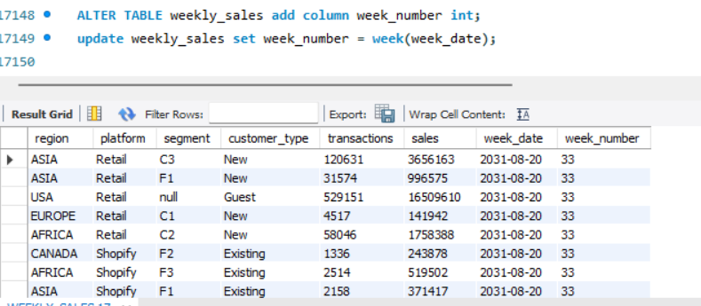
Insight>1 Add a week number as the second column for each week date value, for example any value from the 1st of January to 7th of January will be 1 and 8th to 14th will be 2 etc...
Add Column: ALTER TABLE weekly_sales add column week_number int;
Update week number :update weekly_sales set week_number = week(week_date);

Slide 7
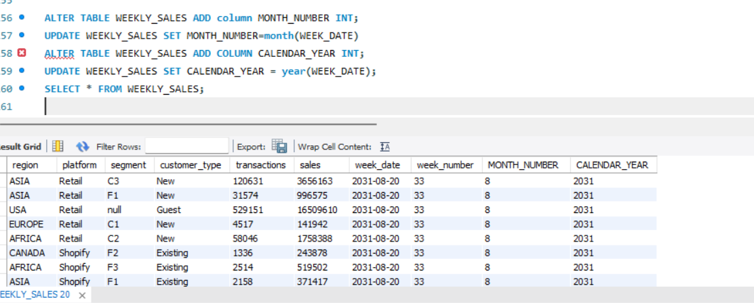
Insight 2 Add month column and update month number from date column; Add Year column and update year number from date column.
For Month:>
For Year:>>
ALTER TABLE WEEKLY_SALES ADD column MONTH_NUMBER INT;
UPDATE WEEKLY_SALES SET MONTH_NUMBER=month(WEEK_DATE)
ALTER TABLE WEEKLY_SALES ADD COLUMN CALENDAR_YEAR INT;
UPDATE WEEKLY_SALES SET CALENDAR_YEAR = year(WEEK_DATE);

Slide 8
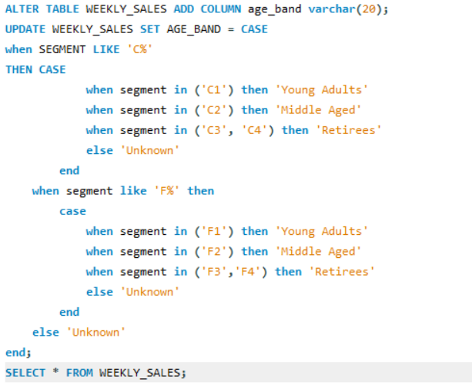
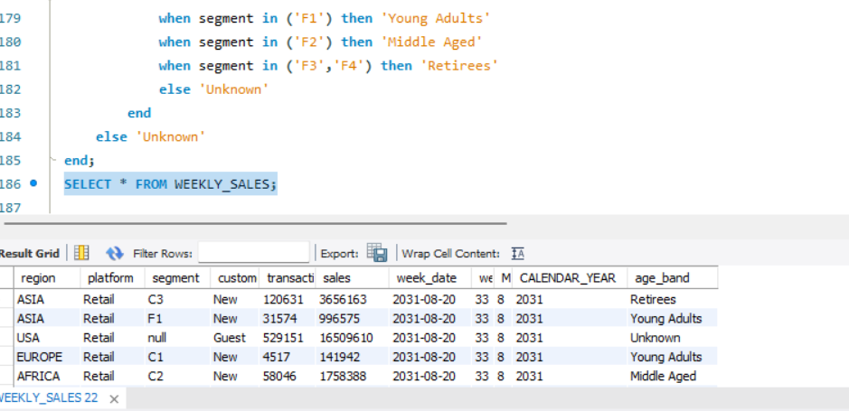
Insight:3
Add a new column called age band after the original segment column using the
following mapping on the number inside the segment value segment
1: Young Adults 2: Middle Aged 3 or 4: Retirees

Slide 9
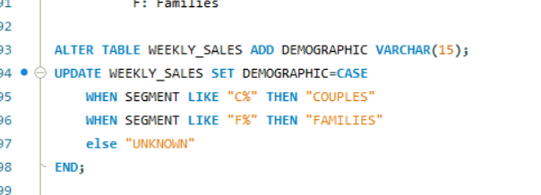
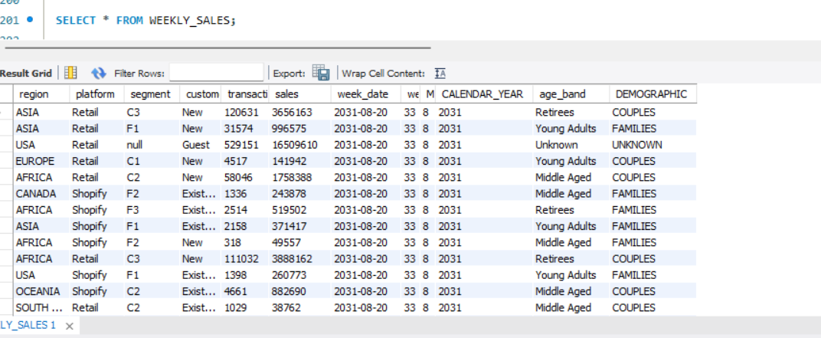
Insight : 4
Add a new demographic column using the following mapping for the first letter
in the segment values segment:
C: Couples F: Families

Slide 10
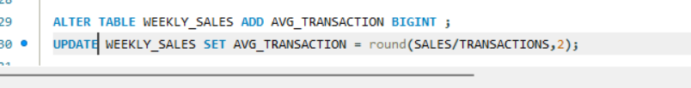
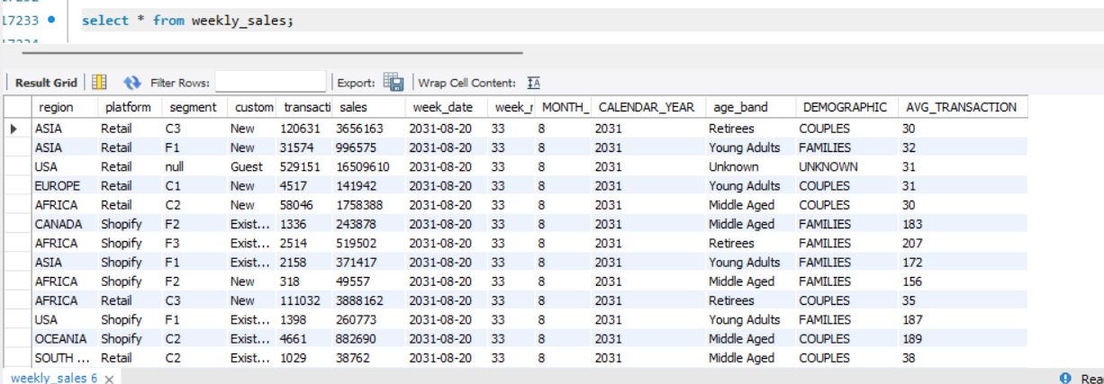
Insight:5 Add a new avg_transaction column as the sales value divided by transactions rounded to 2 decimal places for each record.

Slide 11
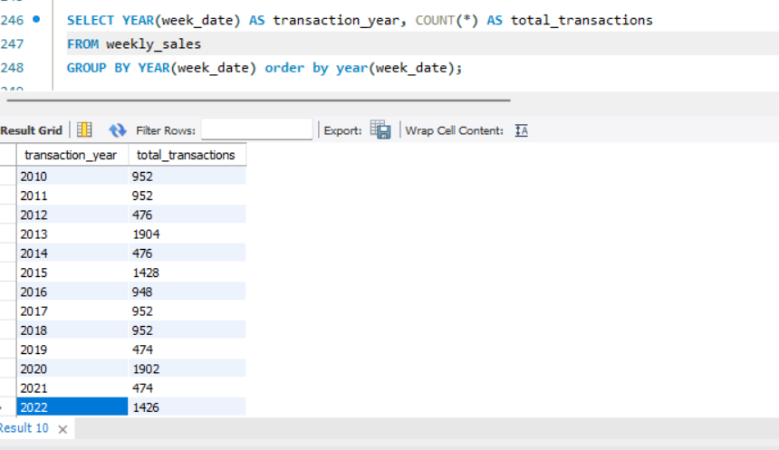
Insight:6 How many total transactions were there for each year in the dataset?
SELECT YEAR(week_date) AS transaction_year, COUNT(*) AS total_transactionsFROM weekly_salesGROUP BY YEAR(week_date) order by year(week_date);

Slide 12
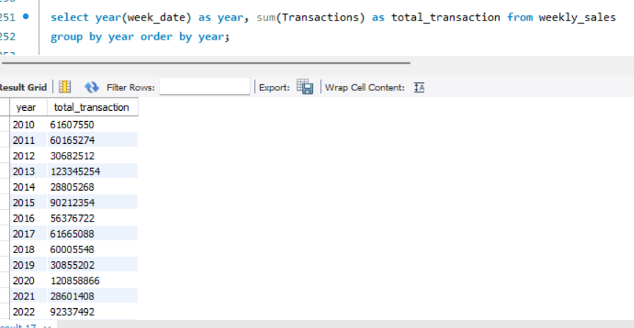
Insight :7
::Sum of transaction Of every Year?
select year(week_date) as year, sum(Transactions) as total_transaction from weekly_salesgroup by year order by year;

Slide 13
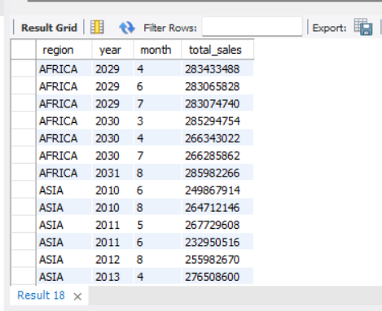

Insight:8
##What is the total sales for each region for each month?
select region,year(week_date)as year,month(week_date)as month,sum(sales) as total_sales from weekly_sales group by region,year,month order by region,year,month;

Slide 14
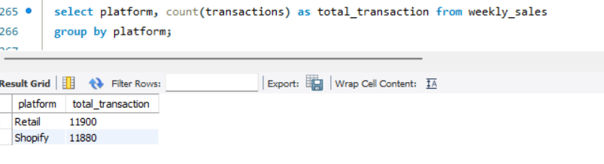
Insight:9
select platform, count(transactions) as total_transaction from weekly_salesgroup by platform;

Slide 15
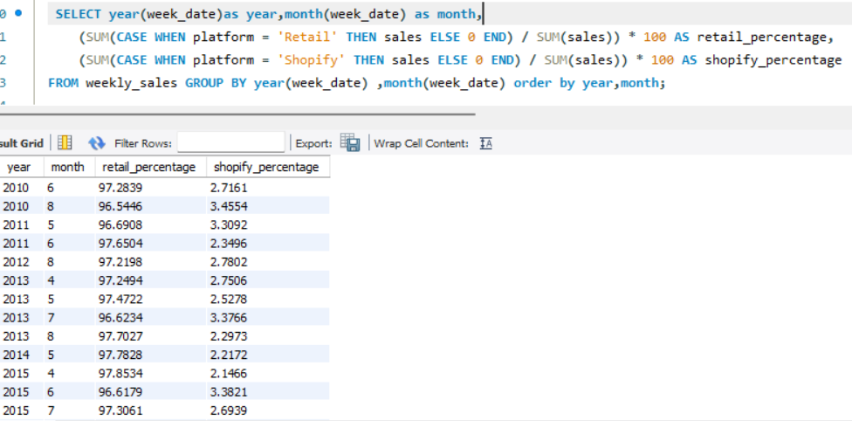
Insight:10
SELECT year(week_date)as year,month(week_date) as month, (SUM(CASE WHEN platform = 'Retail' THEN sales ELSE 0 END) / SUM(sales)) * 100 AS retail_percentage, (SUM(CASE WHEN platform = 'Shopify' THEN sales ELSE 0 END) / SUM(sales)) * 100 AS shopify_percentageFROM weekly_sales GROUP BY year(week_date) ,month(week_date) order by year,month;

Slide 16
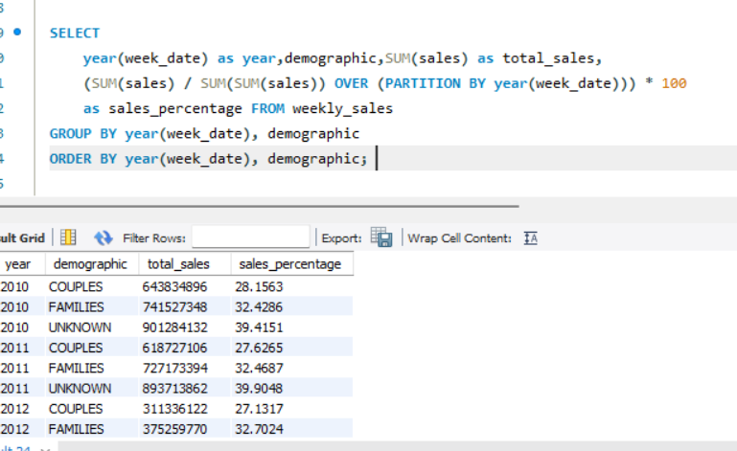
Insight:11
What is the percentage of sales by demographic for each year in the dataset?
SELECT year(week_date) as year,demographic,SUM(sales)as total_sales,(SUM(sales) / SUM(SUM(sales))OVER (PARTITION BY year(week_date))) * 100 as sales_percentage FROM weekly_salesGROUP BY year(week_date), demographicORDER BY year(week_date), demographic;

Slide 17
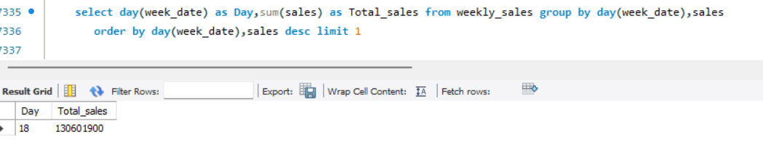
Insight:12
Find the day of the week with the highest total sales._____
select day(week_date) as Day,sum(sales) as Total_sales from weekly_sales group by day(week_date),sales order by day(week_date),sales desc limit 1

Slide 18
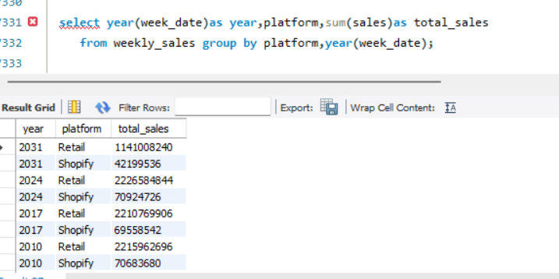
Insight:13
Compare the total sales for Retail and Shopify for each year::
select year(week_date)as year,platform,sum(sales)as total_sales from weekly_sales group by platform,year(week_date);

Slide 19
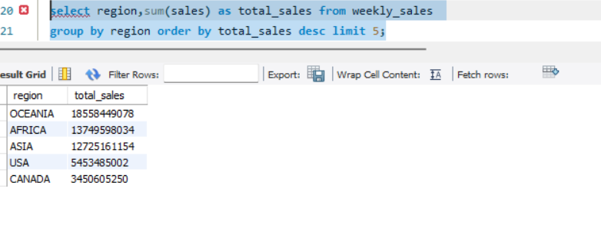
Insight:14
________Identify the top N (e.g., 5) region based on total sales.
select region,sum(sales) as total_sales from weekly_sales group by region order by total_sales desc limit 5;

Slide 20
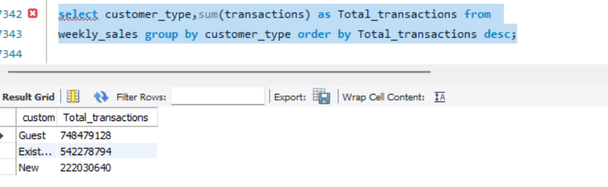
Insight:15
________Identify the customer, considering all their transactions._________
select customer_type,sum(transactions) as Total_transactions from weekly_sales group by customer_type order by Total_transactions desc;

Slide 21
Conclusion
As we conclude our journey through the labyrinth of weekly sales data, the impact of our SQL-driven analysis becomes crystal clear. We've not only examined the numbers but also unearthed meaningful insights that hold the potential to shape our business strategy. The story told by the data is more than just statistical; it's a guide for informed decision-making. SQL, our tool of choice, has proven to be the key that unlocks a treasure trove of knowledge. As we reflect on the insights gained, we envision a future where data continues to guide and propel our business forward. where data isn't just numbers – it's the heartbeat of informed choices and strategic success."

Slide 22

Regards,
Ankit Gangwar
Email
Github
Linked In

